Slide 1
Architecture of Enterprise Applications 15 NoSQL & MongoDB
Haopeng Chen
REliable, INtelligent and Scalable Systems Group (REINS)
Shanghai Jiao Tong University
Shanghai, China
http://reins.se.sjtu.edu.cn/~chenhp
e-mail: chen-hp@sjtu.edu.cn

Slide 2
Contents and Objectives
Contents
Mongo DB specification
Access Mongo DB in Java
Replication & Sharding
Objectives
能够根据数据特性，设计综合运用NoSQL数据库和关系型数据库的数据存储方案，以实现数据访问性能的优化
能够通过分层架构设计并实现跨类型数据存储机制下的数据访问

Slide 3
Big Data！
More data usually beats better algorithms
The good news is that
Big Data is here
The bad news is that
we are struggling to store and analyze it

Slide 4
Big Data
Structured data
is data that is organized into entities that have a defined format, such as XML documents or database tables that conform to a particular predefined schema.
This is the realm of the RDBMS.
Semi-structured data
on the other hand, is looser, and though there may be a schema, it is often ignored, so it may be used only as a guide to the structure of the data
for example, a spreadsheet, in which the structure is the grid of cells, although the cells themselves may hold any form of data.
Unstructured data
does not have any particular internal structure
for example, plain text or image data.

Slide 5
NoSQL DBMS
Since RDBMS is incompetent for massive data storage and processing
NoSQL DBMS has become an emerging technology as a complement to an RDBMS
For example, MapReduce

Slide 6
NoSQL DBMS
Bigtable: A Distributed Storage System for Structured Data
ACM Transactions on Computer Systems, 2008, 26:1–26.
http://static.googleusercontent.com/external_content/untrusted_dlcp/research.google.com/zh-CN//archive/bigtable-osdi06.pdf
Dynamo: amazon’s highly available key-value store
Symposium on Operating Systems Principles, 2007:205–220.
http://web.archive.org/web/20120129154946/http://s3.amazonaws.com/AllThingsDistributed/sosp/amazon-dynamo-sosp2007.pdf
Apache Cassandra
http://cassandra.apache.org/
Apache CouchDB
http://couchdb.apache.org/
MongoDB
http://www.mongodb.com/

Slide 7
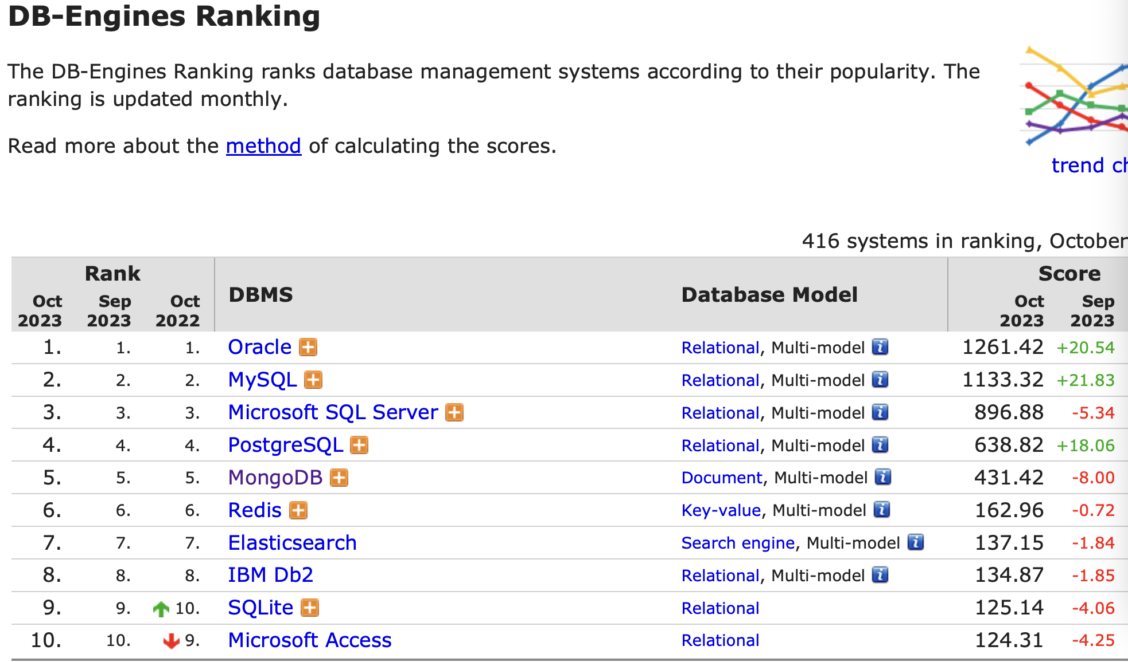
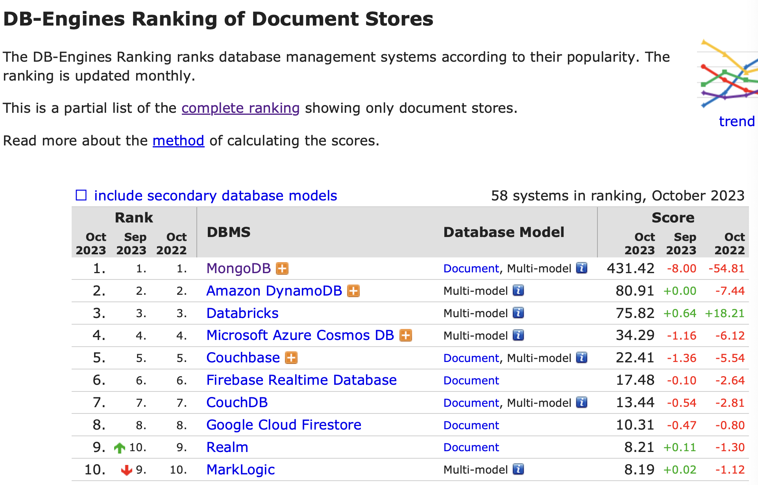
MongoDB
Mongo DB is a document-oriented database.

Slide 8
MongoDB
MongoDB (from "humongous") is an open source document database, and the leading NoSQL database. Written in C++, MongoDB features:
Document-Oriented Storage
Full Index Support
Replication & High Availability
Auto-Sharding
Querying
Fast In-Place Updates
Map/Reduce
GridFS
Commercial Support

Slide 9
Basic concept of MongoDB
A document is the basic unit of data for MongoDB
A collection can be thought of as the schema-free equivalent of a table, the documents in the same collection could have different shapes or types.
Every document has a special key “_id”, it is unique across the document’s collection
Mongo DB groups collections into database and each database has its own permission and be stored in separate disks

Slide 10
Document
Simple document
A document is roughly equivalent to a row in a relational database, which contain one or multiple key-value pairs
{"greeting" : "Hello, world!"}
Most documents will be more complex than this simple one and often will contain multiple key/value pairs:
{"greeting" : "Hello, world!", "foo" : 3}
Key/value pairs in documents are ordered—the earlier document is distinct from the following document:
{"foo" : 3, "greeting" : "Hello, world!"}
Values in documents are not just “blobs.” They can be one of several different data types

Slide 11
Document
Simple document
Keys must not contain the character \0 (the null character).
The . and $ characters have some special properties and should be used only in certain circumstances
Keys starting with _ should be considered reserved; although this is not strictly enforced.
MongoDB is type-sensitive and case-sensitive.
{"foo" : 3}
{"foo" : "3"}
{"Foo" : 3}
Documents in MongoDB cannot contain duplicate keys.
{"greeting" : "Hello, world!", "greeting" : "Hello, MongoDB!"} // illegal

Slide 12
Document
Embedded document
embedded documents are entire Mongo DB documents that are used as the values for a key in another document,
{
"name" : "John Doe",
"address" : {
"street" : "123 Park Street",
"city" : "Anytown",
"state" : "NY"
}
}

Slide 13
Collection
A collection is a group of documents
If a document is the MongoDB analog of a row in a relational database, then a collection can be thought of as the analog to a table.
Collections are schema-free.
This means that the documents within a single collection can have any number of different “shapes.”
{"greeting" : "Hello, world!"}
{"foo" : 5}

Slide 14
Collection
Why should we use more than one collection?
Keeping different kinds of documents in the same collection can be a nightmare for developers and admins.
It is much faster to get a list of collections than to extract a list of the types in a collection.
Grouping documents of the same kind together in the same collection allows for data locality.
We begin to impose some structure on our documents when we create indexes.

Slide 15
Collection
Naming
The empty string ("") is not a valid collection name.
You should not create any collections that start with system.
User-created collections should not contain the reserved character $ in the name.
Subcollections
One convention for organizing collections is to use namespaced subcollections separated by the . character.
For example, an application containing a blog might have a collection named blog.posts and a separate collection named blog.authors.
This is for organizational purposes only—there is no relationship between the blog collection (it doesn’t even have to exist) and its “children.”

Slide 16
Database
In addition to grouping documents by collection, MongoDB groups collections into databases.
A database has its own permissions, and each database is stored in separate files on disk.
A good rule of thumb is to store all data for a single application in the same database.
There are also several reserved database names, which you can access directly but have special semantics. These are as follows:
admin: This is the “root” database, in terms of authentication.
local: This database will never be replicated and can be used to store any collections that should be local to a single server.
config: When Mongo is being used in a sharded setup, the config database is used internally to store information about the shards.

Slide 17
Install MongoDB Community Edition
Mac OS
Tap the MongoDB Homebrew Tap to download the official Homebrew formula for MongoDB and the Database Tools, by running the following command in your macOS Terminal:
brew tap mongodb/brew
To update Homebrew and all existing formulae:
brew update
To install MongoDB, run the following command in your macOS Terminal application:
brew install mongodb-community@7.0
To run MongoDB (i.e. the mongod process) as a macOS service, run:
brew services start mongodb-community@7.0
To stop a mongod running as a macOS service, use the following command as needed:
brew services stop mongodb-community@7.0

Slide 18
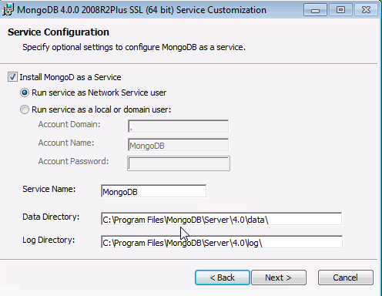
Install MongoDB Community Edition
Windows
Download MongoDB Community Edition
Run the MongoDB installer
Follow the MongoDB Community Edition installation wizard

Slide 19
Connect to a Local Deployment
Connect to a Local Deployment on the Default Port
mongosh
mongosh "mongodb://localhost:27017”
Connect to a Local Deployment on a Non-Default Port
mongosh "mongodb://localhost:28015"
mongosh --port 28015
Connect to a Deployment on a Remote Host
mongosh "mongodb://mongodb0.example.com:28015"
mongosh --host mongodb0.example.com --port 28015

Slide 20
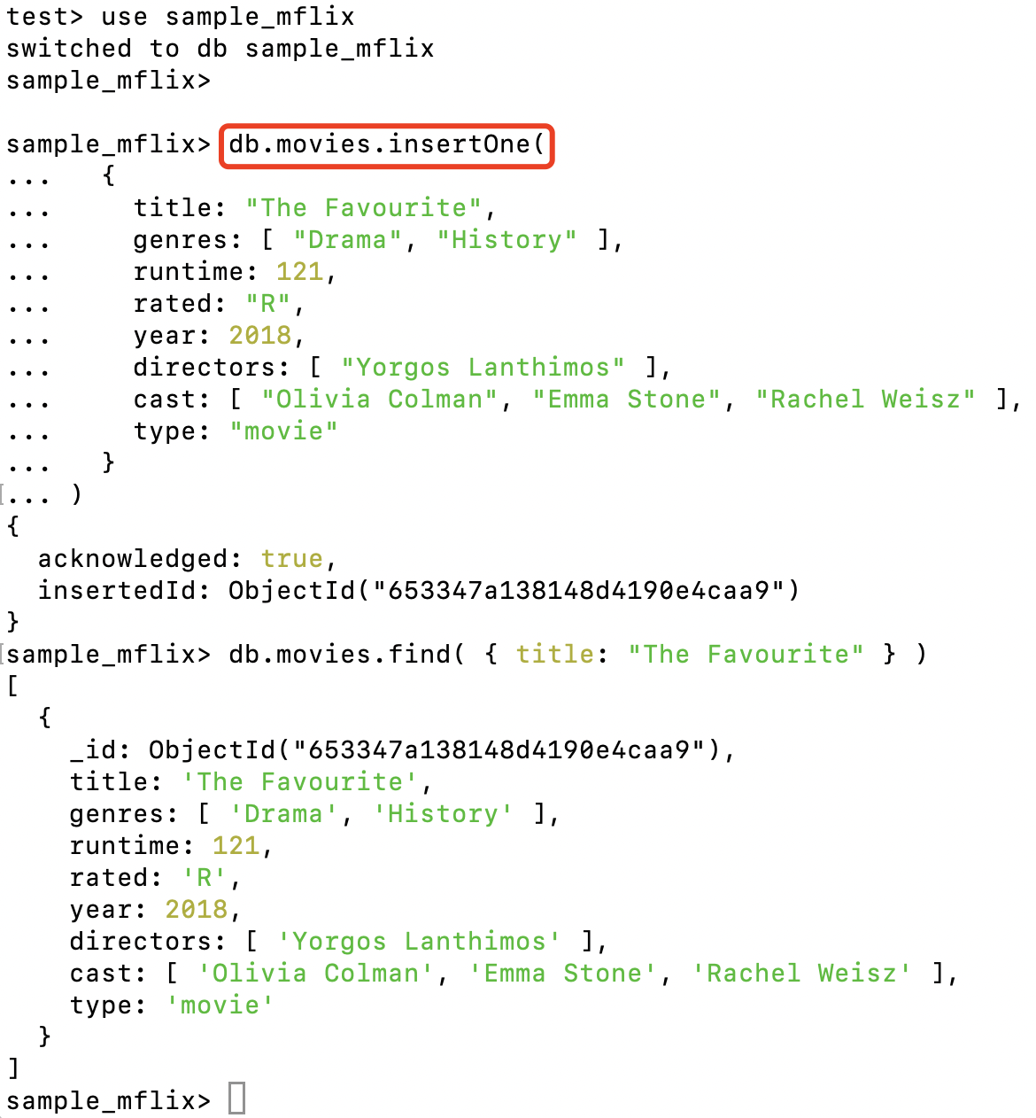
Perform CRUD Operations
Create Operations
Create or insert operations add new documents to a collection. If the collection does not exist, create operations also create the collection.
use sample_mflix
db.movies.insertOne(
{
title: "The Favourite",
genres: [ "Drama", "History" ],
runtime: 121,
rated: "R",
year: 2018,
directors: [ "Yorgos Lanthimos" ],
cast: [ "Olivia Colman", "Emma Stone", "Rachel Weisz" ],
type: "movie"
}
)
Notes:
use sample_mflix
db.movies.insertOne(
{
title: "The Favourite",
genres: [ "Drama", "History" ],
runtime: 121,
rated: "R",
year: 2018,
directors: [ "Yorgos Lanthimos" ],
cast: [ "Olivia Colman", "Emma Stone", "Rachel Weisz" ],
type: "movie"
}
)

Slide 21
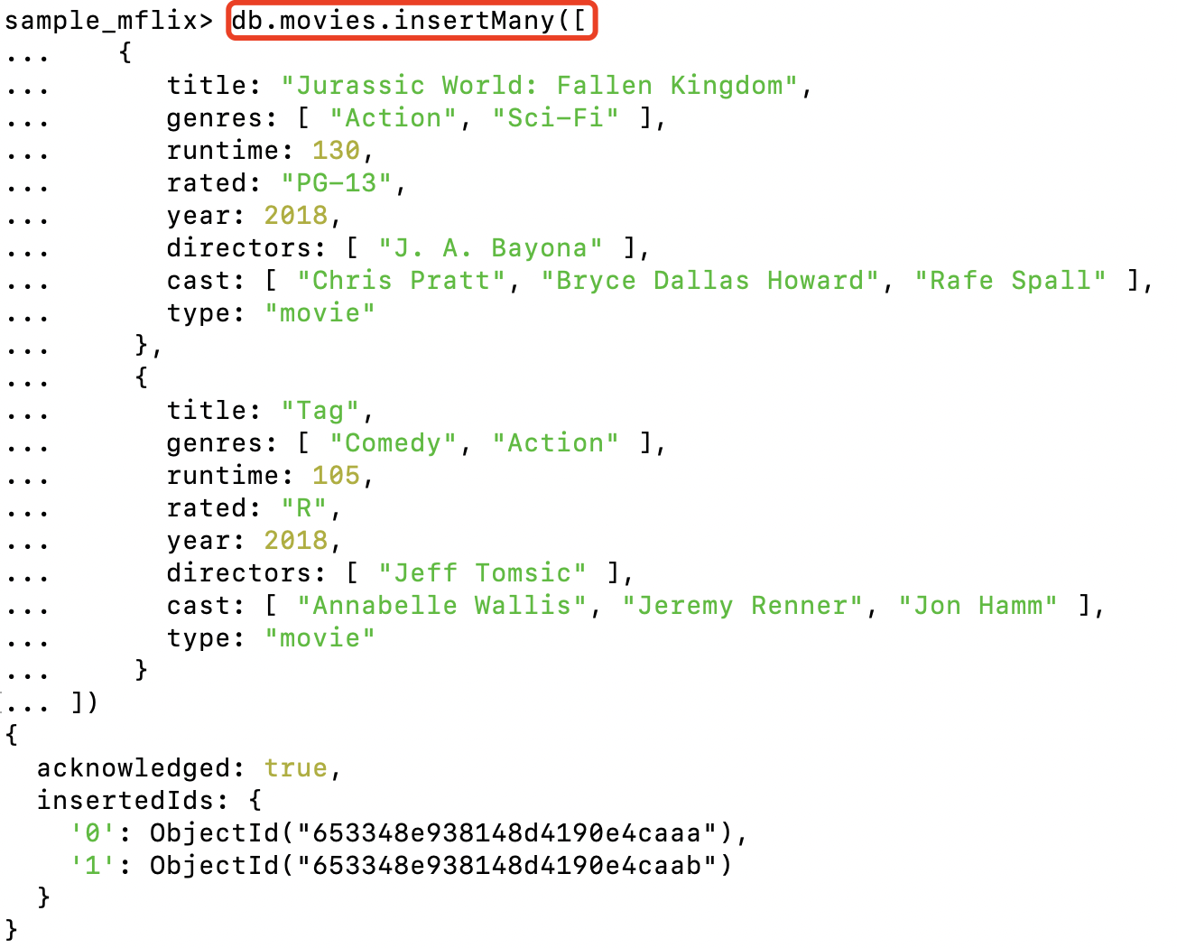
Perform CRUD Operations
Create Operations
use sample_mflix
db.movies.insertMany([
{
title: "Jurassic World: Fallen Kingdom",
genres: [ "Action", "Sci-Fi" ],
runtime: 130,
rated: "PG-13",
year: 2018,
directors: [ "J. A. Bayona" ],
cast: [ "Chris Pratt", "Bryce Dallas Howard", "Rafe Spall" ],
type: "movie"
},
{
title: "Tag",
genres: [ "Comedy", "Action" ],
runtime: 105,
rated: "R",
year: 2018,
directors: [ "Jeff Tomsic" ],
cast: [ "Annabelle Wallis", "Jeremy Renner", "Jon Hamm" ],
type: "movie"
}
])
Notes:
use sample_mflix
db.movies.insertMany([
{
title: "Jurassic World: Fallen Kingdom",
genres: [ "Action", "Sci-Fi" ],
runtime: 130,
rated: "PG-13",
year: 2018,
directors: [ "J. A. Bayona" ],
cast: [ "Chris Pratt", "Bryce Dallas Howard", "Rafe Spall" ],
type: "movie"
},
{
title: "Tag",
genres: [ "Comedy", "Action" ],
runtime: 105,
rated: "R",
year: 2018,
directors: [ "Jeff Tomsic" ],
cast: [ "Annabelle Wallis", "Jeremy Renner", "Jon Hamm" ],
type: "movie"
}
])

Slide 22
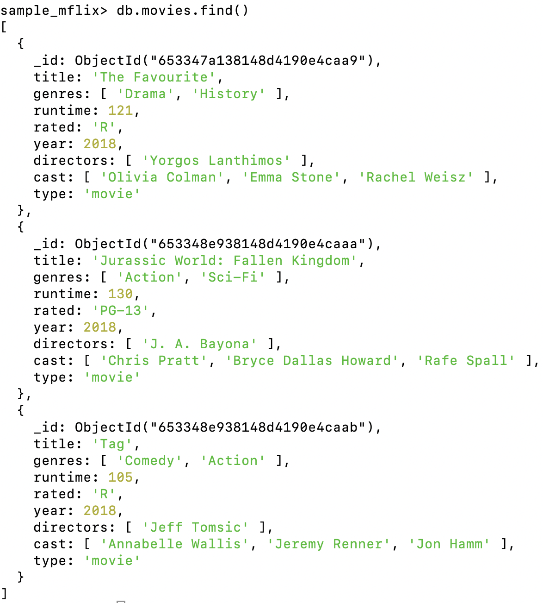
Perform CRUD Operations
Read Operations
Read operations retrieve documents from a collection; i.e. query a collection for documents.
Read All Documents in a Collection
use sample_mflix
db.movies.find()
Notes:
use sample_mflix
db.movies.find()

Slide 23
Perform CRUD Operations
Read Operations
Read operations retrieve documents from a collection; i.e. query a collection for documents.
Specify Equality Condition
To return all movies where the title equals Titanic from the sample_mflix.movies collection:
This operation corresponds to the following SQL statement:
use sample_mflix
db.movies.find( { "title": "Titanic" } )
SELECT * FROM movies WHERE title = "Titanic"
Notes:
use sample_mflix
db.movies.find( { "title": "Titanic" } )

Slide 24
Perform CRUD Operations
Read Operations
Read operations retrieve documents from a collection; i.e. query a collection for documents.
Specify Conditions Using Query Operators
Use query operators in a query filter document to perform more complex comparisons and evaluations. Query operators in a query filter document have the following form:
To return all movies from the sample_mflix.movies collection which are either rated PG or PG-13:
This operation corresponds to the following SQL statement:
{ <field1>: { <operator1>: <value1> }, ... }
use sample_mflix
db.movies.find( { rated: { $in: [ "PG", "PG-13" ] } } )
SELECT * FROM movies WHERE rated in ("PG", "PG-13")
Notes:
use sample_mflix
db.movies.find( { rated: { $in: [ "PG", "PG-13" ] } } )

Slide 25
Perform CRUD Operations
Read Operations
Read operations retrieve documents from a collection; i.e. query a collection for documents.
Specify Logical Operators (AND / OR)
To return movies which were released in Mexico and have an IMDB rating of at least 7:
To return movies from the sample_mflix.movies collection which were released in 2010 and either won at least 5 awards or have a genre of Drama:
use sample_mflix
db.movies.find( { countries: "Mexico", "imdb.rating": { $gte: 7 } } )
use sample_mflix
db.movies.find( {
year: 2010,
$or: [ { "awards.wins": { $gte: 5 } }, { genres: "Drama" } ]
} )
Notes:
use sample_mflix
db.movies.find( { countries: "Mexico", "imdb.rating": { $gte: 7 } } )
use sample_mflix
db.movies.find( {
year: 2010,
$or: [ { "awards.wins": { $gte: 5 } }, { genres: "Drama" } ]
} )

Slide 26
Perform CRUD Operations
Update Operations
Update operations modify existing documents in a collection.
Update Operator Syntax
To update a document, MongoDB provides update operators, such as $set, to modify field values.
To use the update operators, pass to the update methods an update document of the form:
{
<update operator>: { <field1>: <value1>, ... },
<update operator>: { <field2>: <value2>, ... },
...
}

Slide 27
Perform CRUD Operations
Update a Single Document
To update the first document in the sample_mflix.movies collection where title equals "Twilight":
use sample_mflix
db.movies.updateOne( { title: "Twilight" },
{
$set: {
plot: "A teenage girl risks everything–including her life–when she falls in love with a vampire."
},
$currentDate: { lastUpdated: true }
})
Notes:
use sample_mflix
db.movies.updateOne( { title: "Twilight" },{ $set: { plot: "A teenage girl risks everything–including her life–when she falls in love with a vampire." }, $currentDate: { lastUpdated: true }})

Slide 28
Perform CRUD Operations
Update Multiple Documents
To update all documents in the sample_airbnb.listingsAndReviews collection to update where security_deposit is less than 100:
use sample_airbnb
db.listingsAndReviews.updateMany(
{ security_deposit: { $lt: 100 } },
{
$set: { security_deposit: 100, minimum_nights: 1 }
}
)
Notes:
use sample_airbnb
db.listingsAndReviews.updateMany( { security_deposit: { $lt: 100 } }, { $set: { security_deposit: 100, minimum_nights: 1 } })

Slide 29
Perform CRUD Operations
Replace a Document
To replace the first document from the sample_analytics.accounts collection where account_id: 371138:
db.accounts.replaceOne(
{ account_id: 371138 },
{ account_id: 893421, limit: 5000, products: [ "Investment", "Brokerage" ] }
)
Notes:
db.accounts.replaceOne( { account_id: 371138 }, { account_id: 893421, limit: 5000, products: [ "Investment", "Brokerage" ] })

Slide 30
Perform CRUD Operations
Delete Operations
Delete operations remove existing documents from a collection.
Delete All Documents
To delete all documents from the sample_mflix.movies collection:
Delete All Documents that Match a Condition
To delete all documents from the sample_mflix.movies collection where the title equals "Titanic":
use sample_mflix
db.movies.deleteMany({})
use sample_mflix
db.movies.deleteMany( { title: "Titanic" } )
Notes:
use sample_mflix
db.movies.deleteMany({})

Slide 31
Perform CRUD Operations
Delete Operations
Delete operations remove existing documents from a collection.
Delete Only One Document that Matches a Condition
To delete the first document from the sample_mflix.movies collection where the cast array contains "Brad Pitt":
use sample_mflix
db.movies.deleteOne( { cast: "Brad Pitt" } )
Notes:
use sample_mflix
db.movies.deleteMany({})
use sample_mflix
db.movies.deleteMany( { title: "Titanic" } )

Slide 32
Run Aggregation Pipelines
Aggregation pipelines
transform your documents into aggregated results based on selected pipeline stages.
The MongoDB aggregation pipeline consists of stages.
Each stage transforms the documents as they pass through the pipeline.
db.<collection>.aggregate([
{
<$stage1>
},
{
<$stage2>
}
...
])

Slide 33
Run Aggregation Pipelines
Example Aggregation Pipeline
// Third Stage
{ $group:
{ _id: "$genres",
averageGenreRating: { $avg: "$imdb.rating" }
}
},
// Fourth Stage
{ $sort: { averageGenreRating: -1 } }
] )
db.movies.aggregate([
// First Stage
{ $project: { _id: 0, genres: 1,
imdb: 1, title: 1 } },
// Second Stage
{ $unwind: "$genres" },

Slide 34
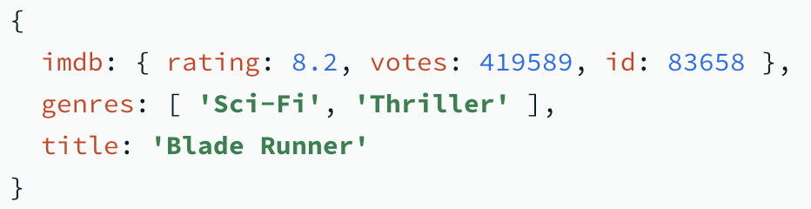
Run Aggregation Pipelines
Example Aggregation Pipeline
First Stage
The $project stage passes documents that contain the following fields to the next pipeline stage:
genres, imdb, title
Documents from the collection that don't include all of these fields are not passed to the next pipeline stage.
// First Stage
{ $project: { _id: 0, genres: 1, imdb: 1, title: 1 } },

Slide 35
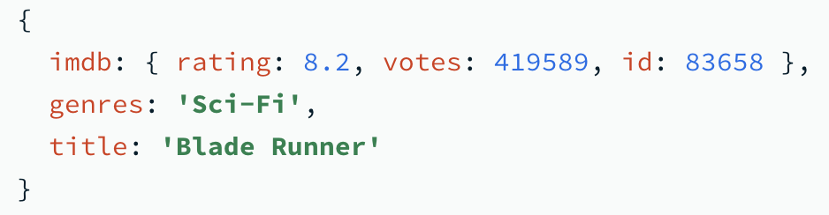
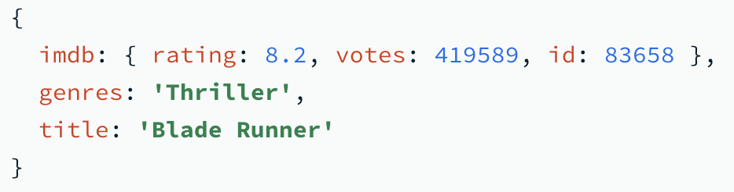
Run Aggregation Pipelines
Example Aggregation Pipeline
Second Stage
The $unwind stage passes a document for each element in the genres array to the next pipeline stage.
// Second Stage
{ $unwind: "$genres" },

Slide 36
Run Aggregation Pipelines
Example Aggregation Pipeline
Third Stage: The $group stage:
Retrieves the distinct genre values from the documents it receives from the previous pipeline stage,
Creates a document for each distinct genre where the _id is the genre name,
Adds a field, averageGenreRating, to each new document that contains the average imdb.rating of all documents that match the genre, and
Passes the new documents to the next pipeline stage.
// Third Stage
{ $group:
{ _id: "$genres", averageGenreRating: { $avg: "$imdb.rating" } }
},

Slide 37
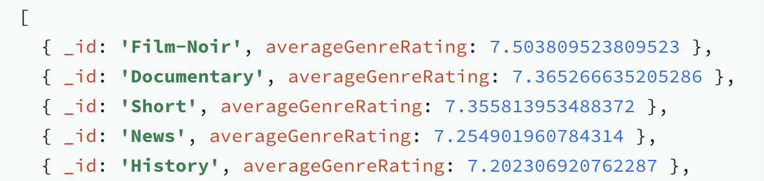
Run Aggregation Pipelines
Example Aggregation Pipeline
Fourth Stage
The $sort stage sorts the documents it receives from the previous stage in descending order based on the value of the averageGenreRating field.
// Fourth Stage
{ $sort: { averageGenreRating: -1 } }

Slide 38
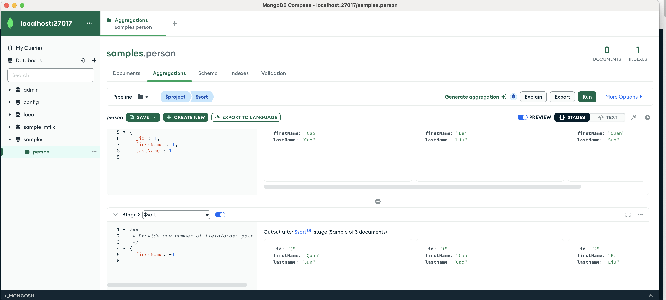
MongoDB Compass
Compass is a free interactive tool for querying, optimizing, and analyzing your MongoDB data. Get key insights, drag and drop to build pipelines, and more.

Slide 39
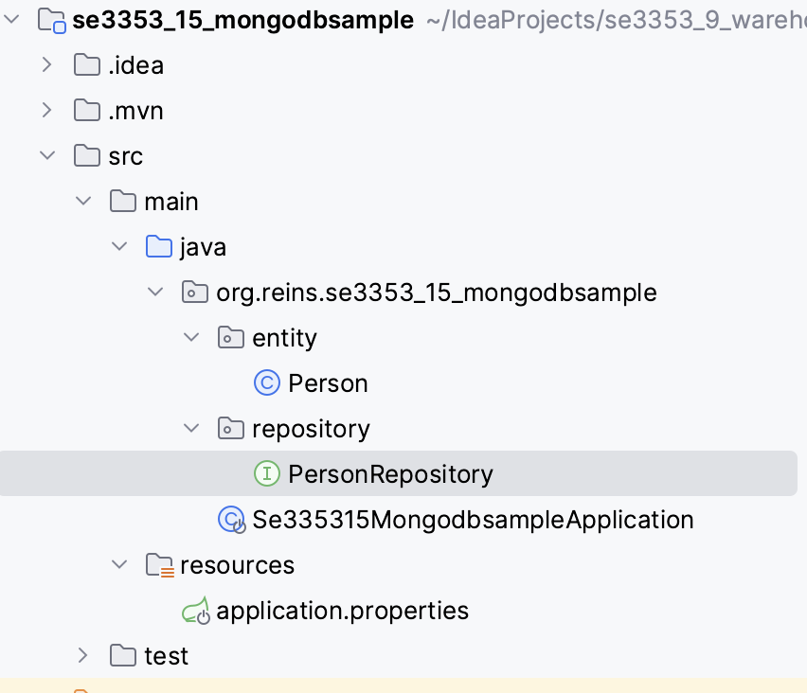
Accessing Data with MongoDB
public class Person { @Id private String id; private String firstName; private String lastName; public Person(String id, String firstName, String lastName){ this.id = id; this.firstName = firstName; this.lastName = lastName; } public String getFirstName() { return firstName; } public void setFirstName(String firstName) { this.firstName = firstName; } public String getLastName() { return lastName; } public void setLastName(String lastName) { this.lastName = lastName; } }
\

Slide 40
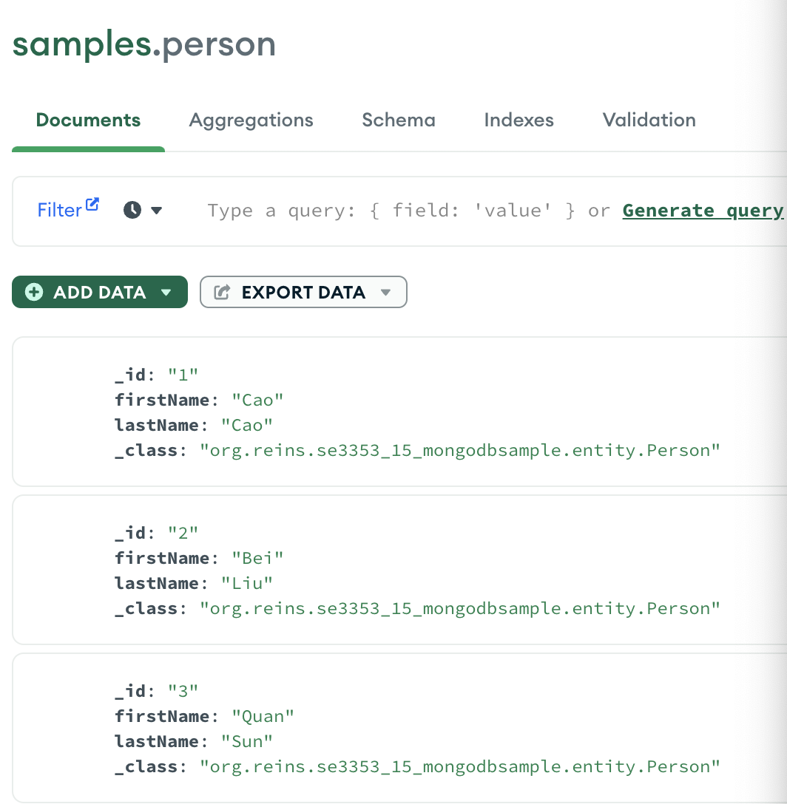
Spring with MongoDB
PersonRepository.java
public interface PersonRepository extends MongoRepository<Person, String> { List<Person> findByLastName(@Param("name") String name); List<Person> findByFirstName(@Param("name") String name); }

Slide 41
Spring with MongoDB
SampleApplication.java
@SpringBootApplication public class SampleApplication implements CommandLineRunner { @Autowired private PersonRepository repository; public static void main(String[] args) { SpringApplication.run(SampleApplication.class, args); } @Override public void run(String... args) throws Exception { repository.deleteAll(); // save a couple of perosns repository.save(new Person("1","Cao", "Cao")); repository.save(new Person("2","Bei", "Liu")); repository.save(new Person("3","Quan", "Sun"));

Slide 42
Spring with MongoDB
SampleApplication.java
// fetch all persons System.out.println("Persons found with findAll():"); System.out.println("-------------------------------"); for (Person person : repository.findAll()) { System.out.println(person.getFirstName() + " " + person.getLastName()); } System.out.println(); // fetch an individual person System.out.println("Persons found with findByFirstName('Bei'):"); System.out.println("--------------------------------"); for (Person person : repository.findByFirstName("Bei")) { System.out.println(person.getFirstName() + " " + person.getLastName()); } System.out.println(); System.out.println(”Persons found with findByLastName('Sun'):"); System.out.println("--------------------------------"); for (Person person : repository.findByLastName("Sun")) { System.out.println(person.getFirstName() + " " + person.getLastName()); } } }

Slide 43
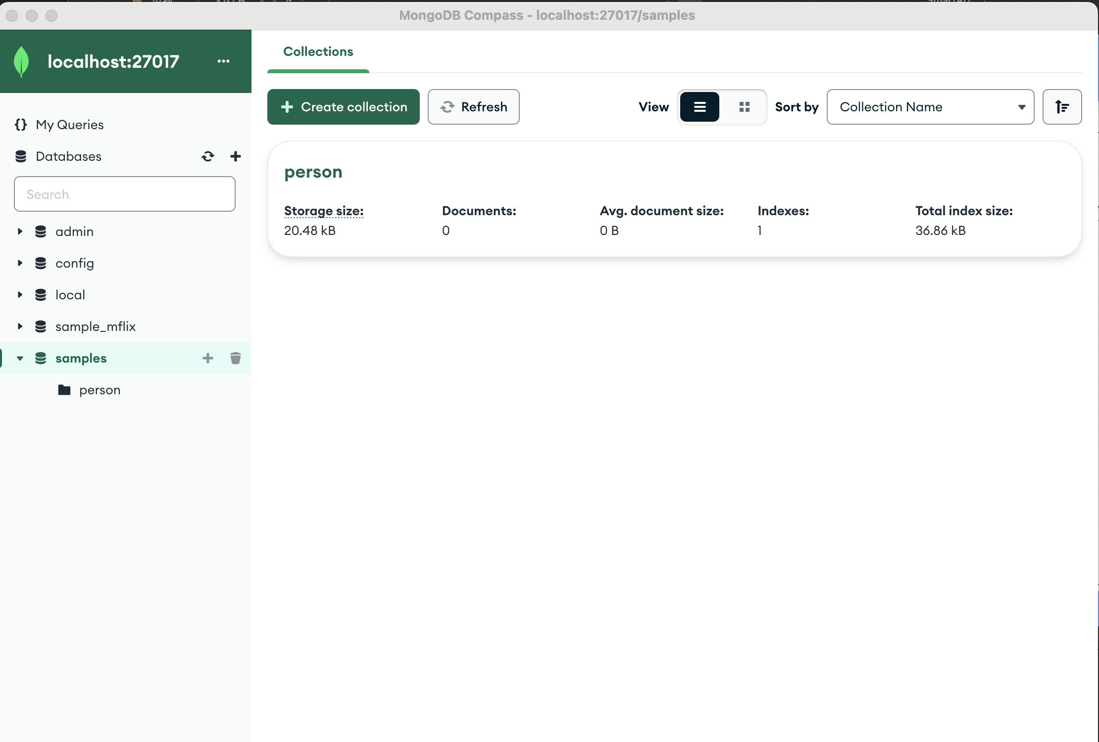
Spring with MongoDB
application.properties
spring.data.mongodb.uri=mongodb://localhost:27017/sample

Slide 44
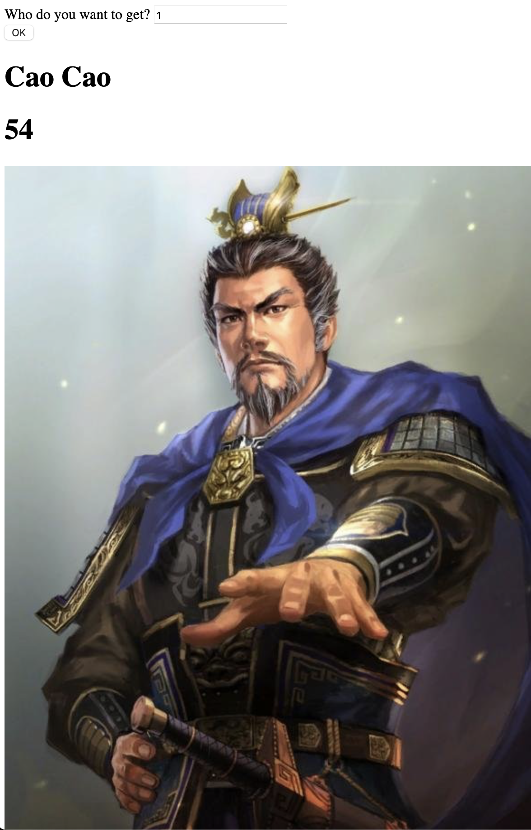
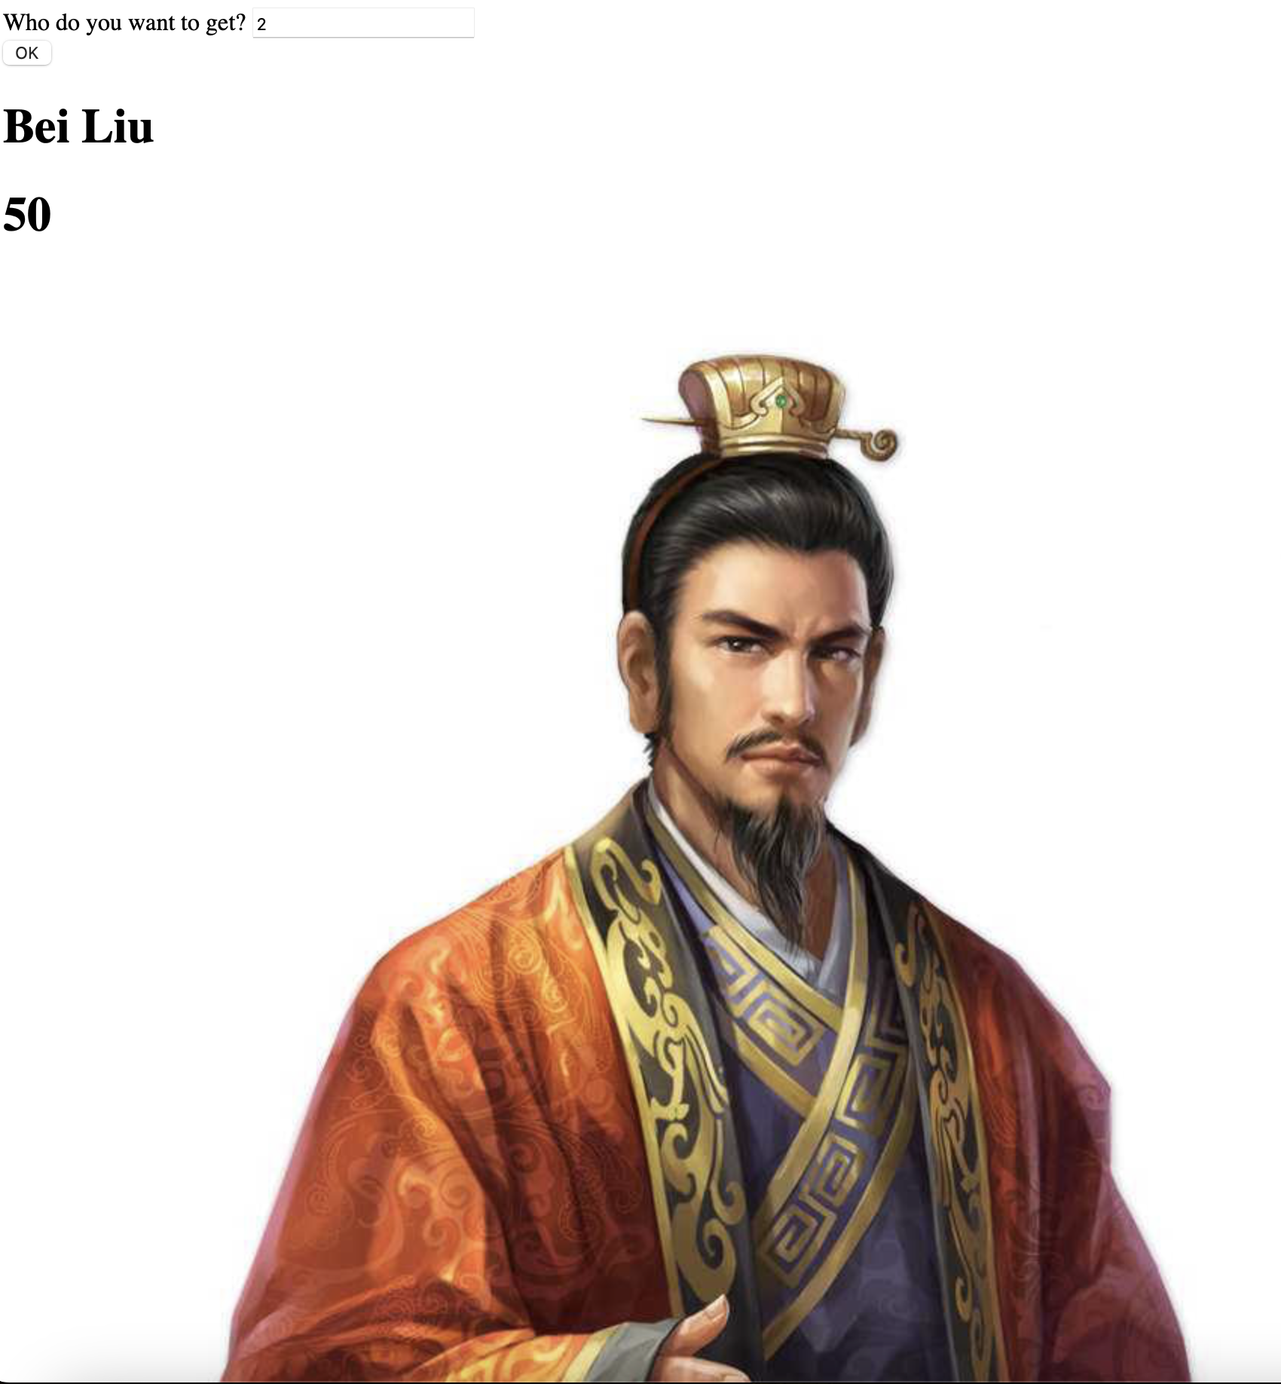
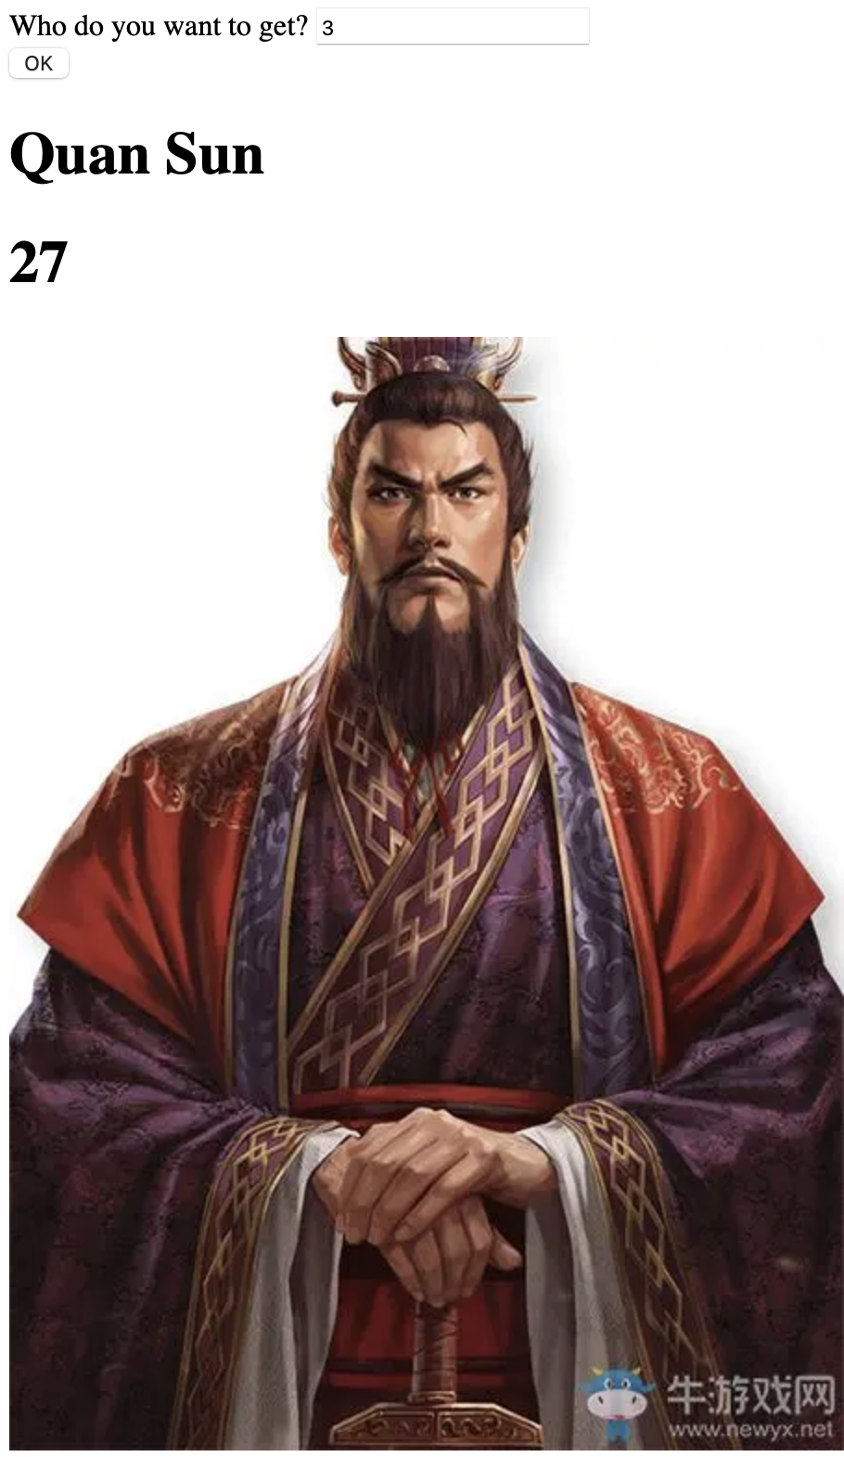
Sanguo App

Slide 45
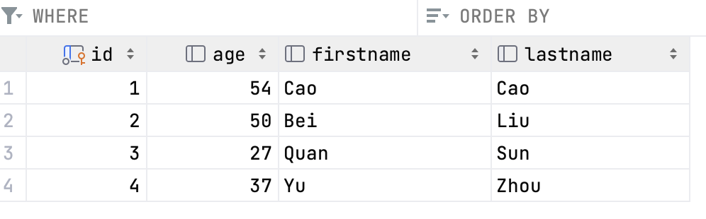
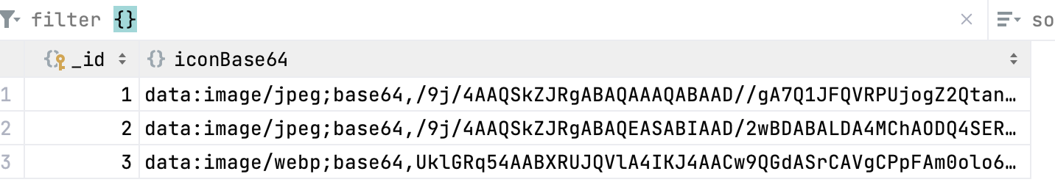
Sanguo App

Slide 46
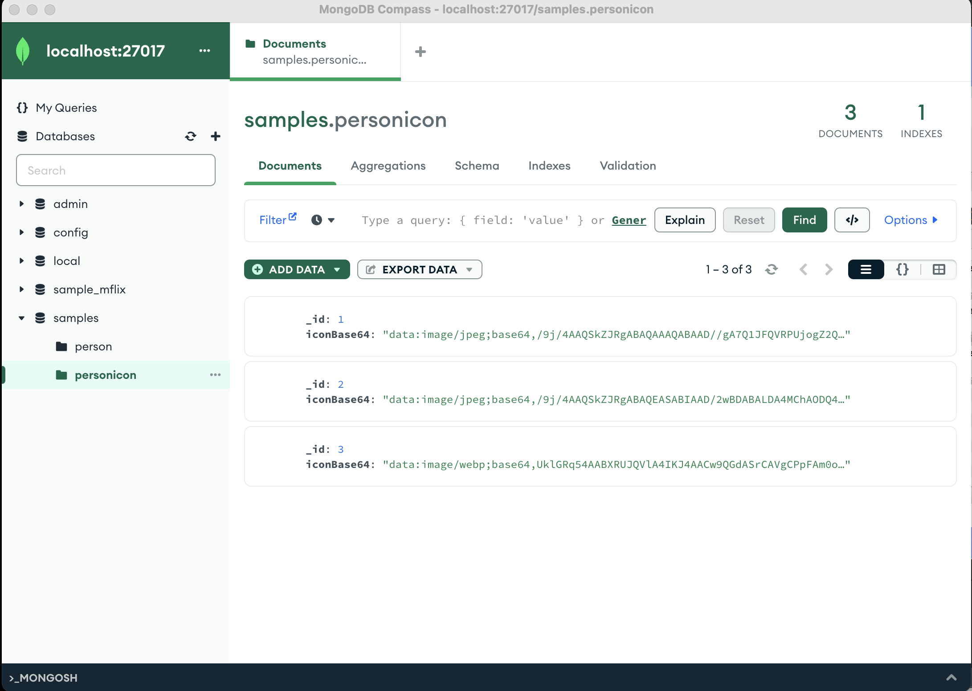
Sanguo App

Slide 47
Sanguo App
PersonIcon.java
@Document(collection = "personicon") public class PersonIcon { @Id private int id; private String iconBase64; public PersonIcon(int id, String iconBase64) { this.id = id; this.iconBase64 = iconBase64; } public String getIconBase64() { return iconBase64; } public void setIconBase64(String iconBase64) { this.iconBase64 = iconBase64; } }

Slide 48
Sanguo App
Person.java
@Entity @Table(name = "persons", schema = "ormsample") @JsonIgnoreProperties(value = {"handler", "hibernateLazyInitializer", "fieldHandler"}) @JsonIdentityInfo( generator = ObjectIdGenerators.PropertyGenerator.class, property = "personId") public class Person { private int personId; private Integer age; private String firstname; private String lastname; @Id @Column(name = "id") public int getPersonId() { return personId; } public void setPersonId(int personId) { this.personId = personId; }

Slide 49
Sanguo App
Person.java
@Basic @Column(name = "age") public Integer getAge() { return age; } public void setAge(Integer age) { this.age = age; } @Basic @Column(name = "firstname") public String getFirstname() { return firstname; } public void setFirstname(String firstname) { this.firstname = firstname; }

Slide 50
Sanguo App
Person.java
@Basic @Column(name = "lastname") public String getLastname() { return lastname; } public void setLastname(String lastname) { this.lastname = lastname; } @Override public boolean equals(Object o) { if (this == o) return true; if (o == null || getClass() != o.getClass()) return false; Person person = (Person) o; if (personId != person.personId) return false; if (age != null ? !age.equals(person.age) : person.age != null) return false; if (firstname != null ? !firstname.equals(person.firstname) : person.firstname != null) return false; if (lastname != null ? !lastname.equals(person.lastname) : person.lastname != null) return false; return true; }

Slide 51
Sanguo App
Person.java
@Override public int hashCode() { int result = personId; result = 31 * result + (age != null ? age.hashCode() : 0); result = 31 * result + (firstname != null ? firstname.hashCode() : 0); result = 31 * result + (lastname != null ? lastname.hashCode() : 0); return result; } private List<Event> activities; @ManyToMany(fetch = FetchType.LAZY, mappedBy = "participants") public List<Event> getActivities() { return activities; } public void setActivities(List<Event> activities) { this.activities = activities; }

Slide 52
Sanguo App
Person.java
private List<String> emails = new ArrayList<String>(); @ElementCollection(fetch = FetchType.EAGER) @CollectionTable(name = "PERSON_EMAIL", joinColumns = {@JoinColumn(name = "person_id", referencedColumnName = "id")}) @Column(name = "EMAIL_ADDRESS") public List<String> getEmails() { return emails; } public void setEmails(List<String> emails) { this.emails = emails; } private PersonIcon icon; @Transient public PersonIcon getPersonIcon(){ return icon; } public void setIcon(PersonIcon icon) { this.icon = icon; } }

Slide 53
Sanguo App
PersonRepository.java
PersonIconRepository.java
public interface PersonRepository extends JpaRepository<Person, Integer>{ }
public interface PersonIconRepository extends MongoRepository<PersonIcon, Integer> { }

Slide 54
Sanguo App
PersonIconRepository.java
@Repository public class PersonDaoImpl implements PersonDao { @Autowired private PersonRepository personRepository; @Autowired private PersonIconRepository personIconRepository; @Override public Person findOne(Integer id) { Person person = personRepository.getOne(id); Optional<PersonIcon> icon = personIconRepository.findById(id); if (icon.isPresent()){ System.out.println("Not Null " + id); person.setIcon(icon.get()); } else{ person.setIcon(null); System.out.println("It's Null"); } return person; } }
PersonRepository.java
public interface PersonDao { Person findOne(Integer id); }

Slide 55
Sanguo App
PersonService.java
PersonServiceImpl.java
public interface PersonService { Person findPersonById(Integer id); }
@Service public class PersonServiceImpl implements PersonService { @Autowired private PersonDao personDao; @Override public Person findPersonById(Integer id){ return personDao.findOne(id); } }

Slide 56
Sanguo App
PersonController.java
@RestController public class PersonController { @Autowired private PersonService personService; @GetMapping(value = "/findPerson/{id}") public Person findPerson(@PathVariable("id") Integer id) { System.out.println("Searching Person: " + id); return personService.findPersonById(id); } }

Slide 57
Sanguo App
index.html
<!DOCTYPE html> <html lang="en"> <head> <meta charset="UTF-8"> <title>Mongo and MySQL</title> <script src="js/jquery-3.4.1.min.js"></script> <script> $(document).ready(function () { $("button").on("click", (function () { $.get("findPerson/"+document.getElementById("who").value, function (data, status) { document.getElementById("name").innerHTML = data["firstname"] + " " + data["lastname"]; document.getElementById("age").innerHTML = data["age"]; let icon = document.getElementById("icon"); icon.src = data["personIcon"]["iconBase64"]; }); })); }); </script> </head>

Slide 58
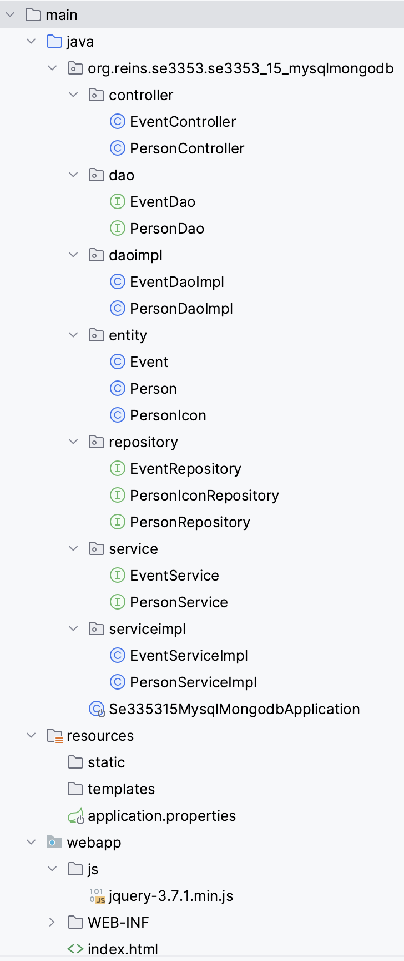
Sanguo App
index.html
<body> Who do you want to get? <input id=who type=text name=name size=20><BR> <button>OK</button> <h1 id="name"></h1> <h1 id="age"></h1> <img id="icon"></img> </body> </html>

Slide 59
Indexing
Normal index
When only a single key is used in the query, that key can be indexed to improve the query’s speed.
> db.people.createIndex({"username" : 1})
As a rule of thumb, you should create an index that contains all of the keys in your query.
> db.people.find({"date" : date1}).sort({"date" : 1, "username" : 1}
> db.createIndex({"date" : 1, "username" : 1})
If you have more than one key, you need to start thinking about index direction.
> db.createIndex{"username" : 1, "age" : -1}.

Slide 60
Indexing
Geospatial Indexing
finding the nearest N things to a current location.
MongoDB provides a special type of index for coordinate plane queries, called a geospatial index.
MongoDB’s geospatial indexes assumes that
whatever you’re indexing is a flat plane.
This means that results aren’t perfect for spherical shapes, like the earth, especially near the poles.

Slide 61
Geospatial Index
A geospatial index can be created using the createIndex function, but by passing "2d" as a value instead of 1 or -1:
To change the default precision, specify a bits value when you create the 2d index. You can specify a bits value between 1 and 32, inclusive.
db.<collection>.createIndex(
{ <location field>: "2d" },
{ bits: <bit precision> }
)

Slide 62
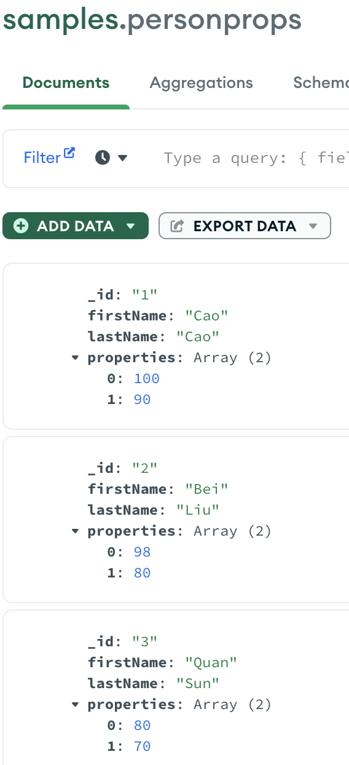
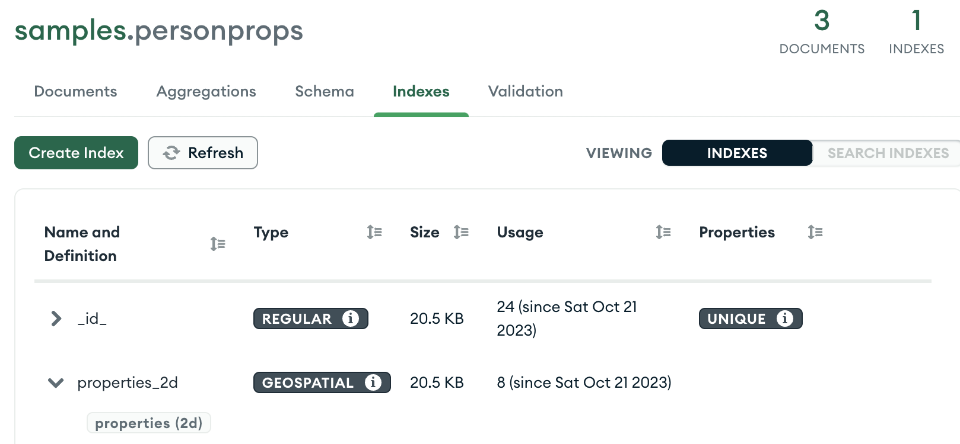
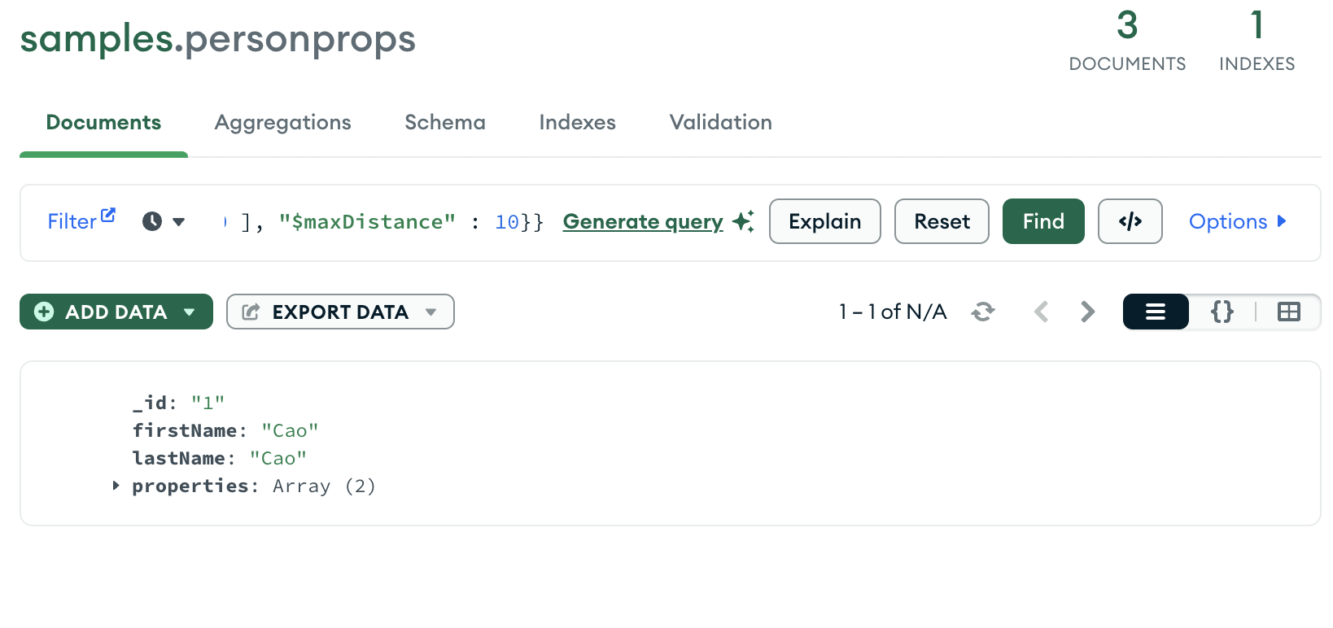
Geospatial Index
{"properties" : {"$near" : [ 100, 90 ], "$maxDistance" : 10}}

Slide 63
Geospatial Index – Spring Boot Project
public String getFirstName() { return firstName; } public void setFirstName(String firstName) { this.firstName = firstName; } public String getLastName() { return lastName; } public void setLastName(String lastName) { this.lastName = lastName; } public int[] getProperties() { return properties; } public void setProperties(int[] properties) { this.properties = properties; } }
Personprops.java
public class Personprops { @Id private String id; private String firstName; private String lastName; private int[] properties; public Personprops(String id, String firstName, String lastName){ this.id = id; this.firstName = firstName; this.lastName = lastName; }

Slide 64
Geospatial Index – Spring Boot Project
PersonRepository.java
public interface PersonRepository extends MongoRepository<Personprops, String> { List<Personprops> findByLastName(@Param("name") String name); List<Personprops> findByFirstName(@Param("name") String name); List<Personprops> findByPropertiesNear(Point location, Distance distance); @Query(value="{ 'firstName' : ?0, 'lastName' : ?1}", fields="{ 'firstName' : 1, 'lastName' : 1}") List<Personprops> findByFirstNameAndLastName(String firstname, String lastname); @Query(value="{'properties' : {'$nearSphere' : ?0, '$maxDistance' : ?1}}") List<Personprops> findByPropertiesRange(Point location, double distance); }

Slide 65
Geospatial Index – Spring Boot Project
Application.java
@SpringBootApplication public class Se335315GeospatialindexApplication implements CommandLineRunner { @Autowired private PersonRepository repository;
@Override public void run(String... args) throws Exception { // fetch all persons System.out.println("Persons found with findAll():"); System.out.println("-------------------------------"); Point point = new Point(100, 90); Distance distance = new Distance(100, Metrics.KILOMETERS); for (Personprops person : repository.findByPropertiesNear(point, distance)) { System.out.println(person.getFirstName() + " " + person.getLastName() + " " + person.getProperties()[0] + " " + person.getProperties()[1] ); } System.out.println();

Slide 66
Geospatial Index – Spring Boot Project
Application.java
// fetch an individual person System.out.println("Persons found with findByFirstNameAndLastName('Bei', 'Liu'):"); System.out.println("--------------------------------"); for (Personprops person : repository.findByFirstNameAndLastName("Bei","Liu")) { System.out.println(person.getFirstName() + " " + person.getLastName() + " " + person.getProperties()); } System.out.println(); // fetch an individual person System.out.println("Persons found with findByPropertiesRange():"); System.out.println("--------------------------------"); point = new Point(100, 90); double dis = 500; for (Personprops person : repository.findByPropertiesRange(point, dis)) { System.out.println(person.getFirstName() + " " + person.getLastName() + " " + person.getProperties()[0] + " " + person.getProperties()[1]); } } }

Slide 67
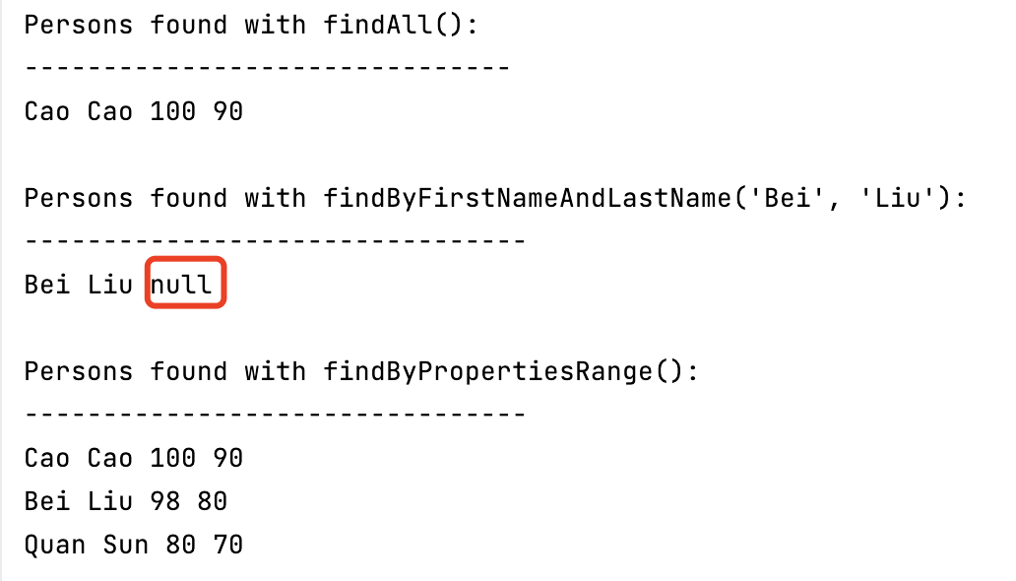
Geospatial Index – Spring Boot Project
Result

Slide 68
An Example of MongoDB App
MySQL
CREATE TABLE IF NOT EXISTS `mobiles` (
`id` int(10) unsigned NOT NULL AUTO_INCREMENT,
`name` VARCHAR(100) NOT NULL,
`brand` VARCHAR(100) NOT NULL, PRIMARY KEY (`id`) );
CREATE TABLE IF NOT EXISTS `mobile_params` (
`id` int(10) unsigned NOT NULL AUTO_INCREMENT,
`mobile_id` int(10) unsigned NOT NULL,
`name` varchar(100) NOT NULL,
`value` varchar(100) NOT NULL, PRIMARY KEY (`id`) );

Slide 69
An Example of MongoDB App
MySQL
INSERT INTO `mobiles` (`id`, `name`, `brand`) VALUES
(1, 'iPhone Xs Max', 'Apple'),
(2, 'S10' , 'Samsung');
INSERT INTO `mobile_params` (`id`, `mobile_id`, `name`, `value`) VALUES
(1, 1, 'Standby time', '200'),
(2, 1, 'Screen', 'OLED'),
(3, 1, 'Quality', 'SSS'),
(4, 2, 'Standby time', '300'),
(5, 2, 'Screen', 'Curve'),
(6, 2, ‘Price', 'Attractive');

Slide 70
An Example of MongoDB App
MySQL
SELECT * FROM `mobile_params`
WHERE name = 'Standby time ' AND value > 100;
SELECT * FROM `mobile_params`
WHERE name = 'Screen' AND value = 'OLED';
The intersection of above two queries is MOBILE_IDS
SELECT * FROM `mobiles` WHERE mobile_id IN (MOBILE_IDS)

Slide 71
An Example of MongoDB App
MongoDB
db.mobiles.createIndex({
"params.name": 1,
"params.value": 1
});
db. mobiles.insertOne({
name: "iPhone Xs Max",
brand: "Apple",
params: [
{name: "Standby time", value : 200},
{name: "Screen", value : "OLED"},
{name: "Quality", value : "SSS"}
]
});

Slide 72
An Example of MongoDB App
MongoDB
db. mobiles.insertOne({
name: " S10",
brand: "Samsung ",
params: [
{name: "Standby time", value : 300},
{name: "Screen", value : "Curve"},
{name: "Price", value : "Attractive"}
]
});

Slide 73
An Example of MongoDB App
MongoDB
db.mobiles.find({
"params": {
$all: [
{$elemMatch: {"name": "Standby time", "value": {$gt: 100}}},
{$elemMatch: {"name": "Screen", "value": "OLED"}}
]
}
});
db.mobiles.find({
"params": {
$all: [
{$elemMatch: {"name": "Standby time", "value": {$gt: 100}}},
{$elemMatch: {"name": "Price", "value": "Attractive"}}
]
}
});

Slide 74
Reference
MongoDB Manual
https://www.mongodb.com/docs/manual/
MongoDB Compass
https://www.mongodb.com/docs/compass/current/
Accessing Data with MongoDB
https://spring.io/guides/gs/accessing-data-mongodb/

Slide 75

Web开发技术
Web Application Development
Thank You!

